Slide 1
CUSTOMER ANALYSIS SYSTEM
M.Perumal
(RA2111003010699)
Voleti Venkata Anjan Sai Kamal
(RA2111028010203)

Slide 2
Aim
The aim of the Customer Analysis System using Tableau is to utilize advanced data visualization techniques to gain comprehensive insights into customer behavior, preferences, and trends. By leveraging Tableau's powerful analytics capabilities, the project aims to enable businesses to make informed decisions, optimize marketing strategies, and enhance overall customer satisfaction.

Slide 3
ABSTRACT
The Customer Analysis System using Tableau is a comprehensive platform designed to facilitate in-depth understanding of customer behavior and preferences. Leveraging Tableau's advanced data visualization capabilities, the system provides interactive and insightful dashboards for effective analysis. Through the integration of diverse data sources, the system enables businesses to make data-driven decisions, optimize marketing strategies, and enhance customer satisfaction. With a focus on intuitive user experience and actionable insights, the system aims to improve customer relationship management and drive sustainable business growth.
TOOLS USED:- tableau and excel

Slide 4
DATASET DESCRIPTION
The dataset for the Customer Analysis System using Tableau contains comprehensive customer information, including demographics, purchase history, and feedback data. It aims to provide insights into customer behavior, preferences, and trends. The dataset is structured with fields such as customer ID, age, gender, transaction details, product categories, and feedback. It is meticulously sourced and curated to facilitate effective customer analysis and inform strategic business decisions.
Key Attributes:
The dataset includes the following key attributes, among others:
- Customer ID
- Name
- Age
- Gender
- Location
- Purchase history
- Order values
- Product categories
- Website engagement metrics
- Marketing campaign responses

Slide 5
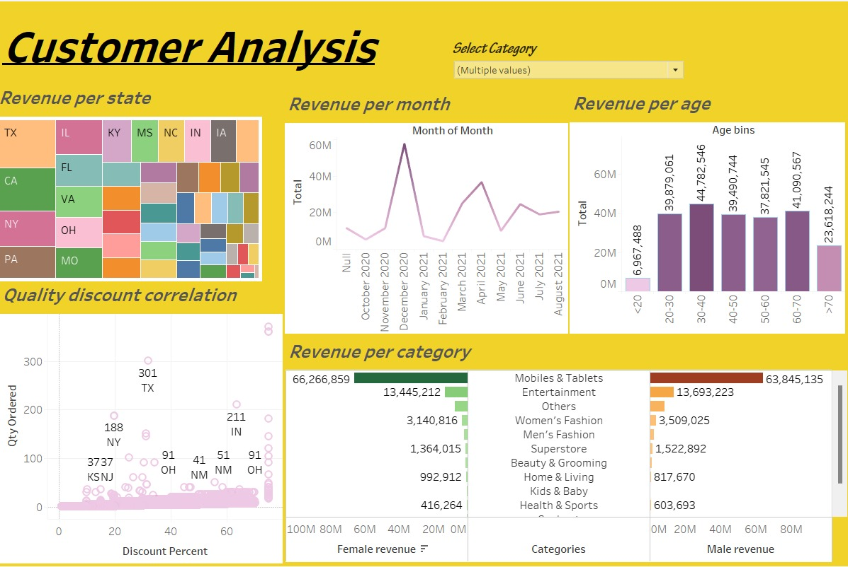
OUTPUT:-

Slide 6
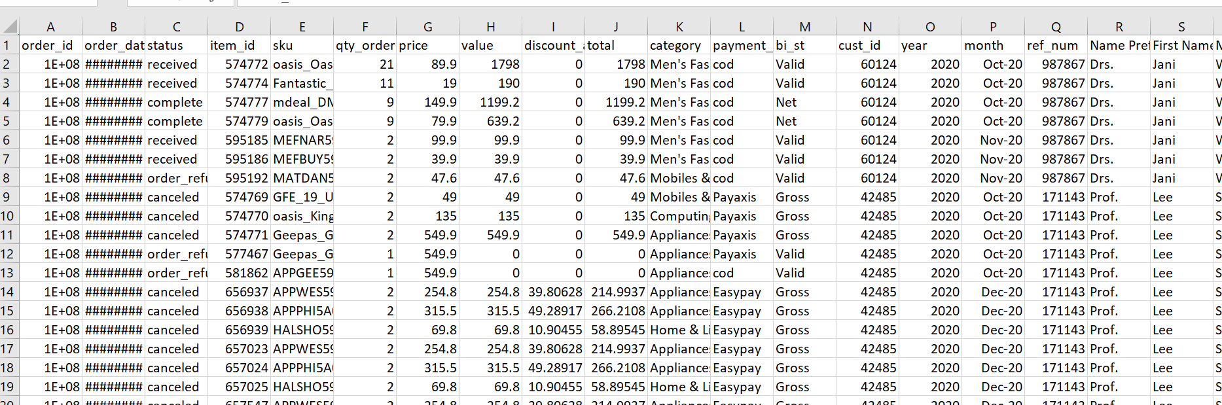
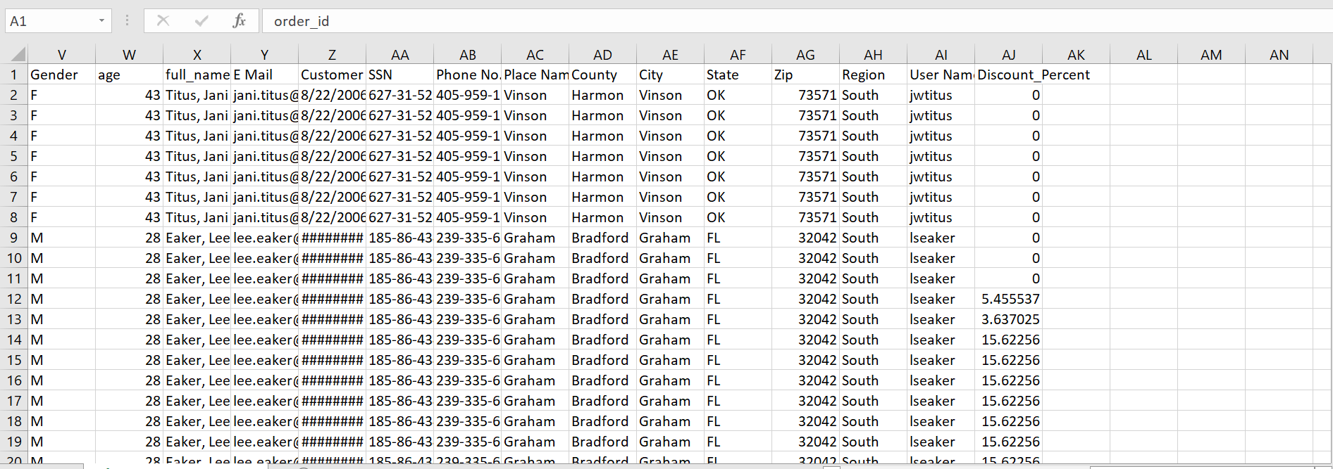
Dataset reference
https://drive.google.com/file/d/1mWW5x02Rw1dt6g9LpodaV8rQnSgIjMeB/view
DATASET SCREENSHOTS

Slide 7
CONCLUSION
In conclusion, the implementation of the customer analysis system using Tableau has proven to be instrumental in facilitating in-depth insights into customer behavior, preferences, and trends. The comprehensive visualization capabilities of Tableau have enabled the identification of key patterns and correlations within the customer dataset, empowering data-driven decision-making processes. By leveraging the analytical power of Tableau, businesses can now make informed strategic decisions aimed at enhancing customer satisfaction, optimizing marketing strategies, and fostering long-term customer relationships, ultimately leading to improved overall business performance and profitability.

Slide 8
THANK YOU

